Slide 1
Exploratory data analysis of TCGA
skin cutaneous melanoma RNA-seq data
AASC2022
Min Zhang, Vivi Arief, Geoff McLachlan, Quan Nguyen, Kaye Basford

Slide 2



Melanoma
The most fatal skin cancer
Australia and New Zealand have the highest rates in the world
Immune checkpoint blockade therapy and molecular targeted therapy only help some patients
The difference between patients, identifying new melanoma genes
Gene expression profiling using RNA-seq now available
Notes:
These indicate the importance of understanding the difference between melanoma patients, and identifying new melanoma genes, which could help with the development of new, precise treatments.
In recent years, gene expression profiling… allows for a deeper understanding of var

Slide 3
Exploratory data analysis (EDA)
Clustering
Principal Component Analysis (PCA)
Notes:
Because of…
summarise the main characteristics and highlight the potential patterns in the data
Comprehensible, easier for visualisation

Slide 4
Methods
The Cancer Genome Atlas (TCGA) skin cutaneous melanoma
5,000 genes x 473 melanoma samples (104 primary, 369 metastasized)
Ward’s method of hierarchical clustering
PCA biplots
Enrichment analysis (Enrichr)
Notes:
So, in our study, we analyzed the melanoma RNA-seq data from TCGA using EDA
Joint representation of…
Got a list… used enrichment analysis to suggest…

Slide 5
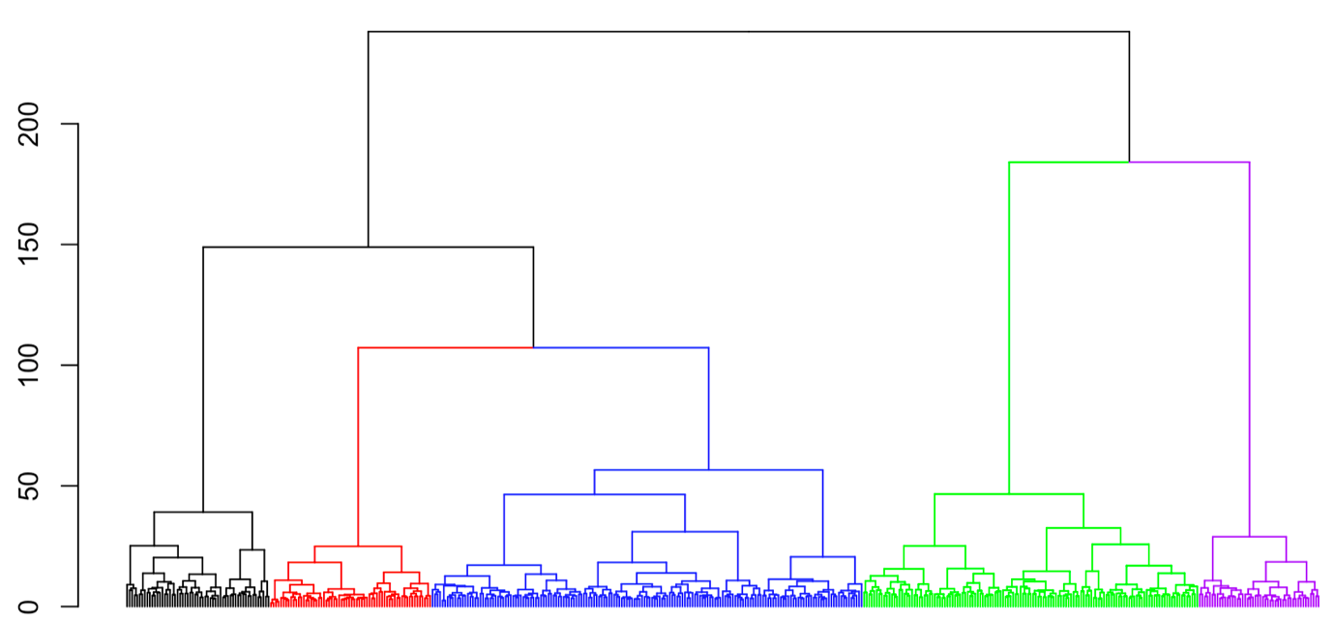
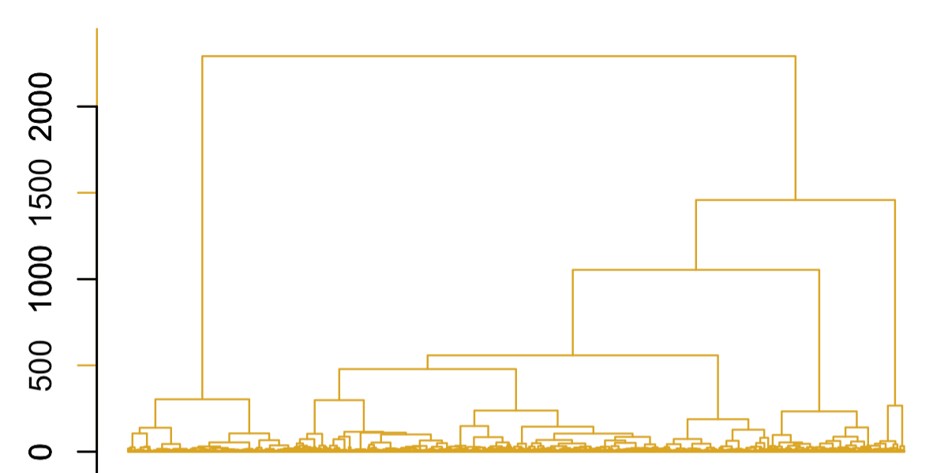
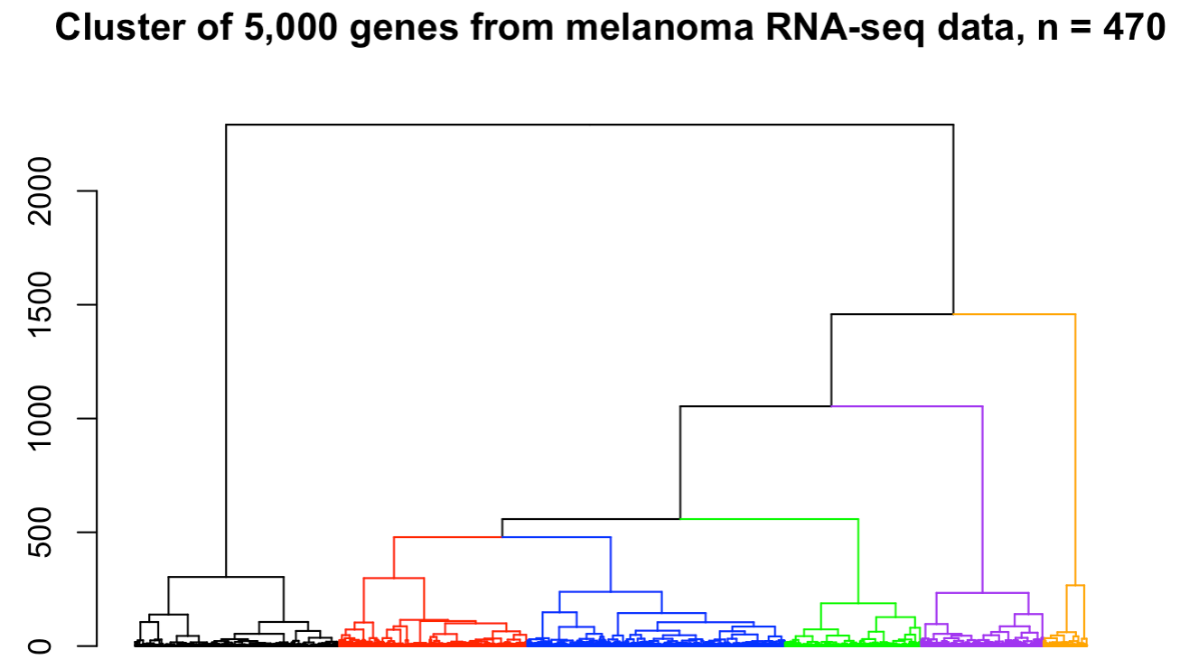
Results – clustering (Ward’s method)
(a) 473 melanoma samples
(b) 5,000 genes
(a)
(b)
1 2 3 4 5
1 2 3 4 5 6
Notes:
Here are our key results, starting from…

Slide 6
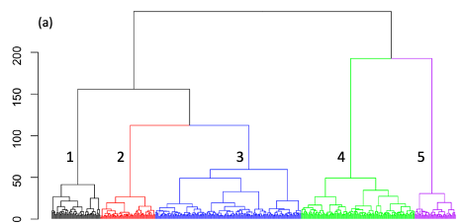
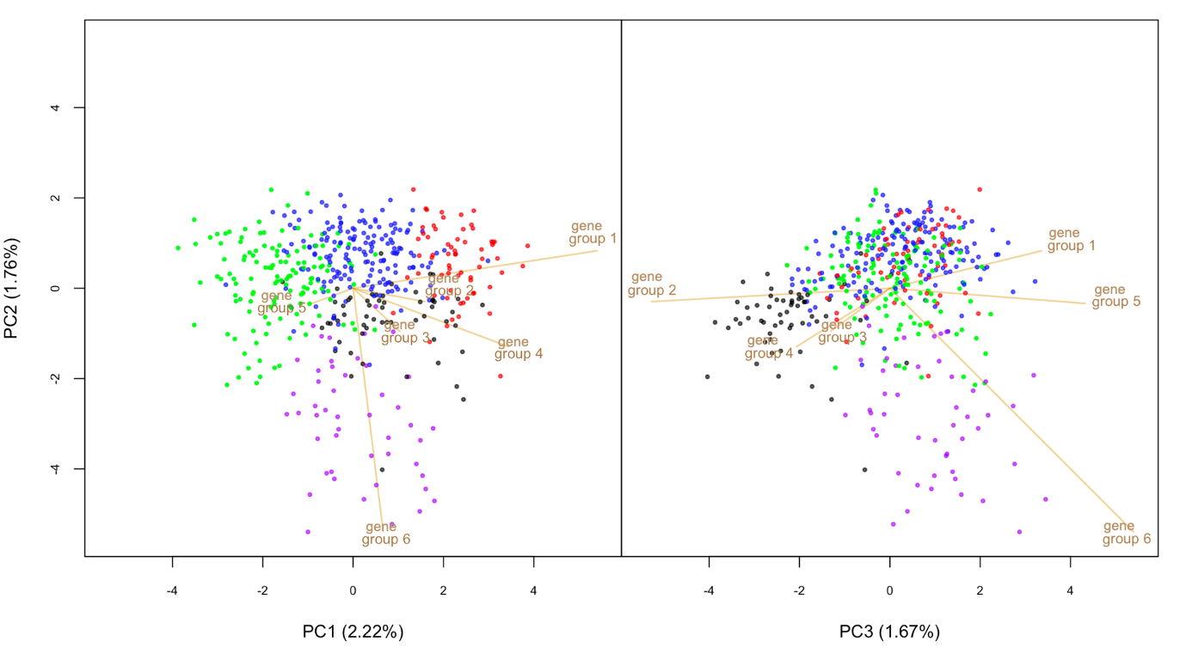
Results – PCA
Gene groups 1 & 5: red vs blue vs green samples
Gene group 6: purple samples vs rest
Gene groups 2 & 4: black samples vs rest
Notes:
Point, vector (direction and length). Perpendicularly.
PC1: red, blue, green; PC2: purple vs. other; PC3: black.
Purple distinct?

Slide 7
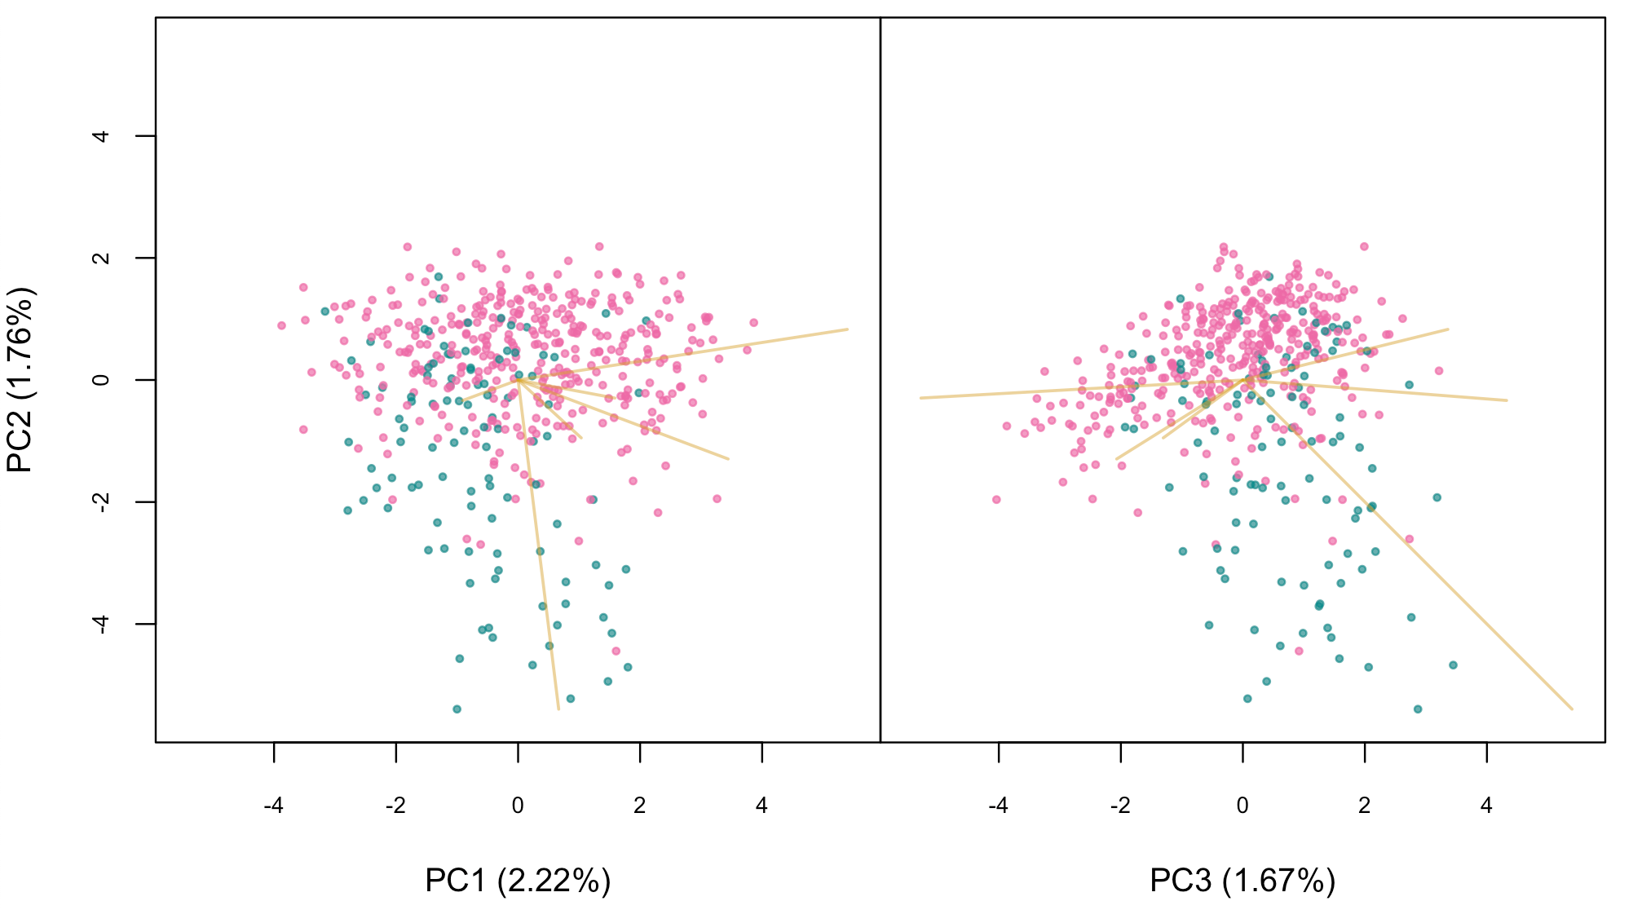
Results – PCA
primary
metastasized
Most (85%) purple samples from last slide are primary melanoma
Gene group 6: associated with the separation of primary and metastasized samples
gene
group 1
gene
group 1
gene
group 2
gene
group 2
gene
group 5
gene
group 5
gene
group 3
gene
group 4
gene
group 4
gene
group 3
gene
group 6
gene
group 6
Notes:
Not a complete separation, there’s no doubt…
have their PC2 values at least 5 SDs (0.69) from the mean (-0.27)

Slide 8
Enrichment Analysis
Selected 93 genes from Gene group 6
Enrichment analysis (using “Enrichr”): Fisher’s exact test to associate genes with functional biological terms (by querying genes against gene-set libraries that were created from prior knowledge)
Enrichr (https://maayanlab.cloud/Enrichr/)
Notes:
(the most extreme genes of all 5,000 genes on the PC2 score, being more than 5.5 standard deviations from the overall mean)
Q&A: From the previous analysis, PC2 appeared to be most associated with primary cancers. Calculated the mean (-0.27) and standard deviation (0.69) of the PC2 values for each of the 5,000 genes and selected those that had PC2 values at least 5.5 standard deviations from the mean. This returned 93 genes and all of them belonged to Gene group 6 – corresponding to about 40% of the genes in this group.

Slide 9
Results from Enrichr
Transcription factors: GRHL3, ZNF750, and TP63 (all p < 0.0001)
Signalling pathways: RIPK4, apoptotic cleavage of cell adhesion proteins, and oncostatin M (all p < 0.0001)
Biological processes: epidermis development, epidermal cell differentiation (all p < 0.0001)
Unlinked genes: possibly important in melanoma progression
Notes:
Significantly, very small p-values.
All TFs and SPs linked with cancer progression in literature.
Enriched genes important in… suggesting the potential importance of ep. devlop. In melanoma progression.

Slide 10
Summary
Power of exploratory data analysis
93 genes for melanoma progression
Potential novel melanoma genes for further investigation
Notes:
By identifying genes DE between melanoma samples.
Variations between pri. and metas. samples and provided a list of…

Slide 11
Thank you
Funding sources to attend AASC2022:
The University of Queensland (UQ) Travel Award
Statistical Society of Australia (SSA) Conference Scholarship

